Slide 1


ASSIGNMENT
Presented by – Ngamdun Naiham
ACCP270124
SUBJECT-MEDICINAL CHEMISTRY II
B.PHARM SEM V
Presented to-
Bidyut JK Boruah
Assistant Professor
This Photo by Unknown Author is licensed under CC BY-SA

Slide 2
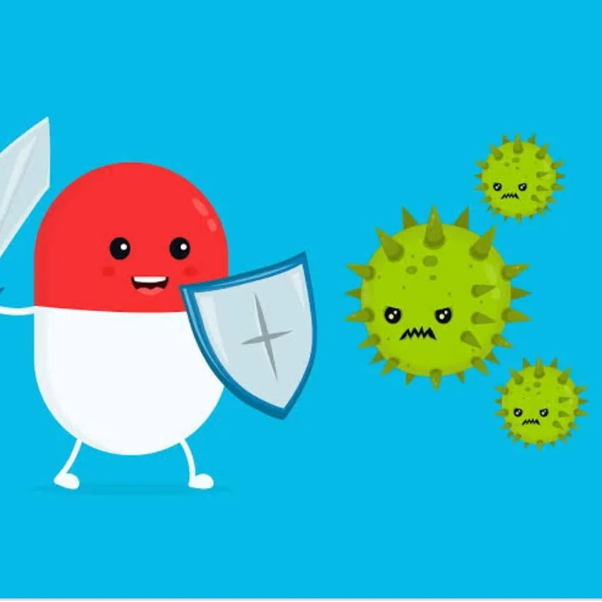
ANTI – DIABETICS AGENTS
Diabetes: Diabetes is a chronic disease that occurs either when the pancreas does not produce enough insulin or when the body cannot effectively use the insulin it produces.
Antidiabetics agents: agents when are used in the treatment of diabetes are called as antidiabetics agents. They used to lower the blood sugar level in patients suffering from hyperglycaemia. These are also called as anti- hyperglycaemia agents.

Slide 3
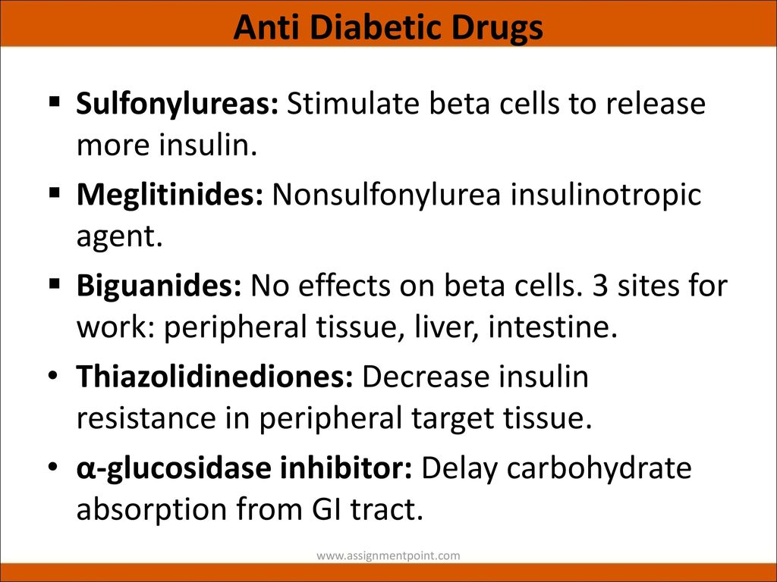

Slide 4
MEGLITINIDES
Short acting insulin secretagogues
Hence used for post-prandial hyperglucemia
Metabolised in liver and excreted in kidney. Hence, dose to be reduced in both liver and renal failure.

Slide 5
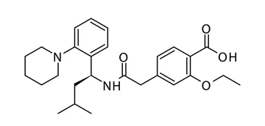
Repaglinide- 2-ethoxy-4-
It induces fast onset and short-lasting insulin secretion. Administered before each meal to control post-prandial hyperglycaemia.
[2-[3-methyl-1-[2-(piperidin-1-yl)phenyl]butylamino]-2-oxo-ethyl] benzoic acid

Slide 6
Mechanism of Action: Repaglinide is an insulin secretagogue, meaning it binds to receptors on pancreatic beta cells and stimulates insulin release. Repaglinide binds to an ATP-dependent potassium channel on beta cells, known as SUR1, bringing about its closure.
Used as oral hypoglycaemic agent for treatment of type-2 diabetes.
Side Effects of REPAGLINIDE
Headache
Stomach pain
Sign of a common cold
Diarrhoea
Joint pain
Back pain

Slide 7
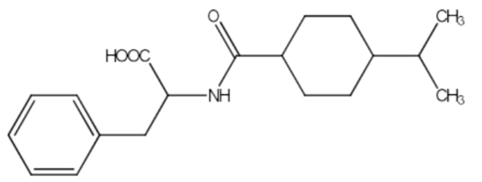
NATEGLINIDE: It’s a phenylalanine derivative. Causes faster onset and short-lasting insulin secretion than repaglinide.

Slide 8
Used as oral hypoglycaemic agent for treatment of type-2 diabetes.
Mechanism of Action:
Nateglinide is an amino-acid derivative that lowers blood glucose levels by stimulating insulin secretion from the pancreas. This action is dependent upon functioning beta-cells in the pancreatic islets. Nateglinide interacts with the ATP-sensitive potassium (K+ATP) channel on pancreatic beta-cells.
SIDE EFFECTS:
Low blood sugar (see below)
Infection in the nose or throat, sore throat, fever, aches and pains
Back pain
Dizziness
Joint pain
Diarrhea

Slide 9
THANK YOU

